Slide 1
Architectural Design

Slide 2
Objectives
To introduce architectural design and to discuss its importance
To explain the architectural design decisions that have to be made
To introduce three complementary architectural styles covering organisation, decomposition and control
To discuss reference architectures are used to communicate and compare architectures

Slide 3
Topics covered
Architectural design decisions
System organisation
Decomposition styles
Control styles
Reference architectures

Slide 4
Software architecture
The design process for identifying the sub-systems making up a system and the framework for sub-system control and communication is architectural design.
The output of this design process is a description of the software architecture.

Slide 5
Architectural design
An early stage of the system design process.
Represents the link between specification and design processes.
Often carried out in parallel with some specification activities.
It involves identifying major system components and their communications.

Slide 6
Advantages of explicit architecture
Stakeholder communication
  Architecture may be used as a focus of discussion by system stakeholders.
System analysis
  Means that analysis of whether the system can meet its non-functional requirements is possible.
Large-scale reuse
  The architecture may be reusable across a range of systems.

Slide 7
Architectural design
Hofmeister ,el al.,2000 suggest that the software architecture
  can serve as a design plan that is used to negotiate system requirements &
  As a means structuring discussions with client, developers & managers.
  It is an essential tool for complexity management; it hides details & allows the designer to focus on the key system abstractions

Slide 8
Architectural design
System affects the performance, robustness(strength), distributability & maintainability of the system.
The particular style & structure of system architecture depends on the non functional requirements.

Slide 9
Architecture and system characteristics
Performance
  Localize critical operations and minimize communications. Use large rather than fine-grain components to reduce component communications.
Security
  Use a layered architecture with critical assets in the inner layers & with a high level of security validation applied to these layers.
Safety
  Localize safety-related operations in either a single subsystem or a small number of sub-systems.
  This reduces costs & problems of safety validation &
  Makes it possible to provide a protected system
Availability
  Architecture should be designed to include redundant components so that it is possible to replace & update components without stopping the system
  These are the features used for fault tolerance systems.
Maintainability
  Since it is a critical requirement, architecture should be designed using fine-grain, replaceable components.

Slide 10
Architectural design process
System structuring
The system is decomposed into several principal sub-systems and communications between these sub-systems are identified
Control modelling
A model of the control relationships between the different parts of the system is established
Modular decomposition
The identified sub-systems are decomposed into modules

Slide 11
System structuring
Concerned with decomposing the system into interacting sub-systems.
The architectural design is normally expressed as a block diagram presenting an overview of the system structure.
More specific models showing how sub-systems share data, are distributed and interface with each other may also be developed.

Slide 12
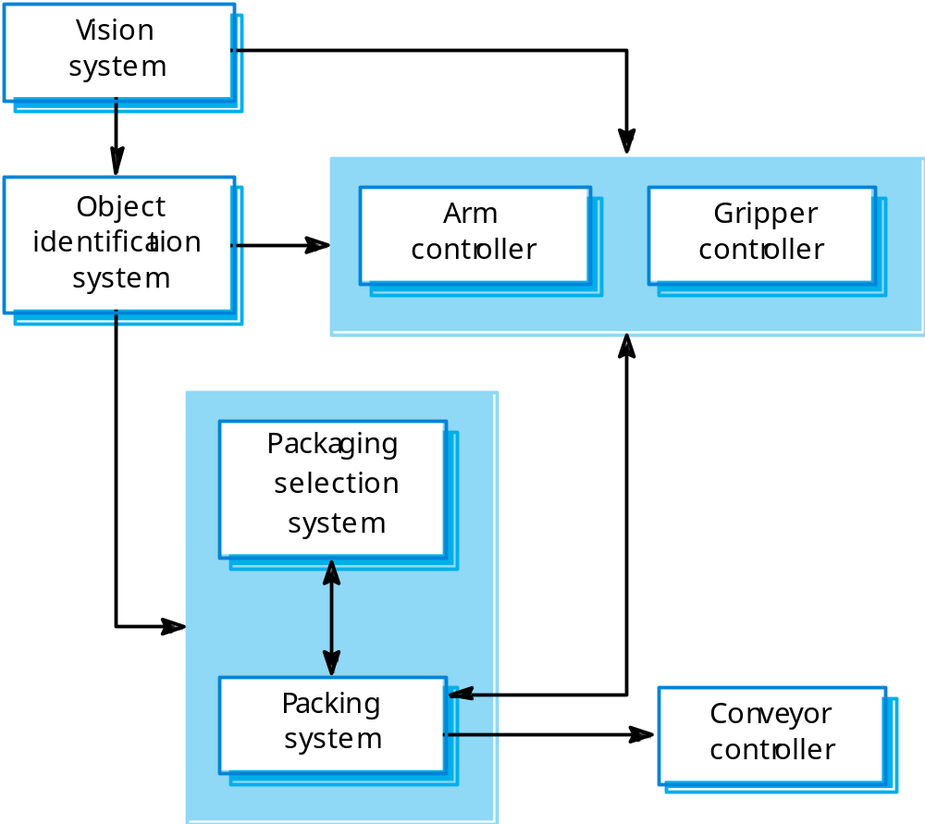
Example- Packing robot control system

Slide 13
Example- Packing robot control system
Fig above is the abstract model of the architecture for packaging robot system that shows the sub systems that have to be developed.
This robotic system can pack different kinds of object.
It uses vision subsystem to pick out objects on a conveyer

Slide 14
Example- Packing robot control system
Identify the type of object &
Select the right kind of packaging
The system then moves the objects from the delivery to be packaged
It places the packaged objects on another conveyer.

Slide 15
Box and line diagrams
Very abstract - they do not show the nature of component relationships nor the externally visible properties of the sub-systems.
However, useful for communication with stakeholders and for project planning.
General problem – To decide how to decompose system into sub-system is difficult one.
  Where system requirement are the major factor
  Thus, if the requirement change, this change is likely to be localized rather than distributed across several sub- system.

Slide 16
Architectural design decisions
It is a creative process where one tries to establish a system organization that will satisfy the functional & non functional system requirements
Activities within the process differs radically depending on the
  type of system being developed
  The background & experience of the system architect &
  The specific requirement of the system
Thus, consider architectural design process from decision perspective rather than from activity perspective.

Slide 17
Architectural design decisions
During architectural design process, system architects have to make many fundamental decisions based on their knowledge & experience, have to answer the following fundamental questions:

Slide 18
Architectural design decisions
Is there a generic application architecture that can be used?
How will the system be distributed?
What architectural styles are appropriate?
How will the system be decomposed into modules?
How will the architectural design be evaluated?
How should the architecture be documented?

Slide 19
Architecture reuse
Systems in the same domain often have similar architectures that reflect domain concepts.
Application product lines are built around a core architecture with variants that satisfy particular customer requirements.

Slide 20
Architectural styles
The architectural model of a system may conform to a generic architectural model or style such as client-server or layered architecture.
An awareness of these styles, their applications, their strength/weaknesses can simplify the problem of defining system architectures.
However, most large systems are heterogeneous and do not follow a single architectural style.

Slide 21
Architectural design
The product of the architectural design process – is the architectural design document
It includes number of graphical representations of the system along with associated descriptive text.
Should describe how the system is structured into sub- systems, an approach is adapted & how each subsystem is structured into modules
Graphical model of the system present different perspectives on the architecture. Architectural models that may be developed may include

Slide 22
Architectural models
Interface model that defines sub-system interfaces.
Relationships model such as a data-flow model that shows sub-system relationships.
Distribution model that shows how sub-systems are distributed across computers.
A number of researchers proposed the use of architectural description language(ADL) to describe system architecture –
  however, it is difficult to understand & use
  Thus, difficult to analyse from practical perspective

Slide 23
System organization
Reflects the basic strategy that is used to structure a system.
Three organizational styles are widely used:
  A shared data repository style;
  A shared services and servers style;
  An abstract machine or layered style.

Slide 24
The repository model
Sub-systems making up a system must exchange information so that they work together effectively.
This may be done in two ways:
  Shared data is held in a central database or repository and may be accessed by all sub-systems;
  Each sub-system maintains its own database and passes data explicitly to other sub-systems.
When large amounts of data are to be shared, the repository model of sharing is most commonly used.
Suited for applications where data is generated by one sub-system and used by another.

Slide 25
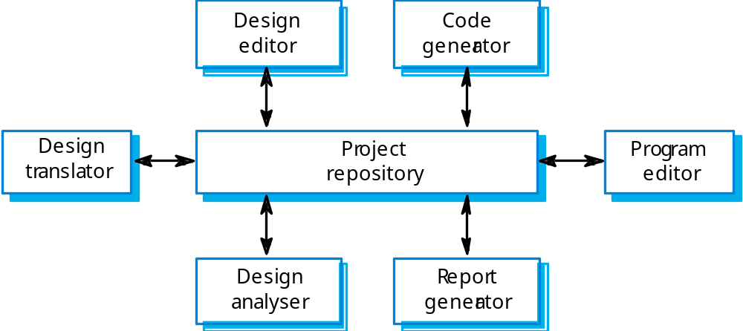
Example-CASE toolset architecture

Slide 26
Repository model characteristics
Advantages
  Efficient way to share large amounts of data;
  Sub-systems need not be concerned with how data is produced Centralised management e.g. backup, security, etc.
  Sharing model is published as the repository schema.
Disadvantages
  Sub-systems must agree on a repository data model. Inevitably a compromise;
  Data evolution is difficult and expensive;
  No scope for specific management policies;
  Difficult to distribute efficiently.

Slide 27
Client-server model
A system model where the system is organized as a set of services and associated servers and clients that access & use the services.
i.e. Distributed system model which shows how data and processing is distributed across a range of components.
The major components of this model are:
A set of servers that offer services to other subsystems such as printing, data management, etc.
A set of clients that call on services offered by the servers.
A network that allows clients to access these services.

Slide 28
Client-server model
Clients may have to know the names of the available servers & the services they provide
However, servers need not know either the identity of clients and their number.
Clients accesses the service from remote procedural call using request reply protocol such as http.

Slide 29
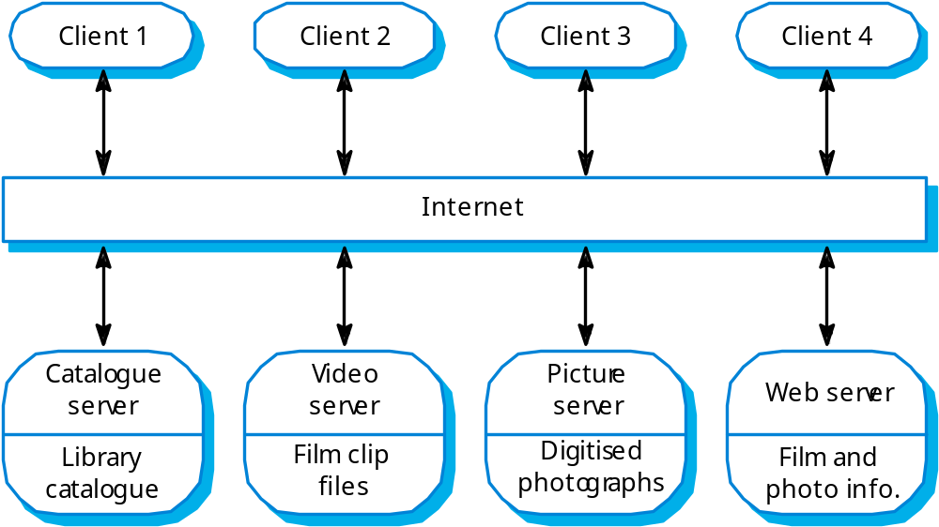
Example-Film and picture library

Slide 30
Example-Film and picture library
It is multi-user, web based system
Several servers manage & display the different types of media
Video frames need to be transmitted quickly and in synchrony but with low resolution
Video servers may handle video compression/ decompression into different formats to be stored in a store
Still pictures must be maintained at a high resolution so must be maintained in a separate server.

Slide 31
Client-server characteristics
Advantages
  Distribution of data is straightforward;
  Makes effective use of networked systems. May require cheaper hardware;
  Easy to add new servers or upgrade existing servers.
Disadvantages
  No shared data model so sub-systems use different data organisation. Data interchange may be inefficient;
  Redundant management in each server;
  No central register of names and services - it may be hard to find out what servers and services are available.

Slide 32
Abstract machine (layered) model
Used to model the interfacing of sub-systems.
Organises the system into a set of layers (or abstract machines) each of which provide a set of services.
Each layer can be thought of as an abstract machine whose machine language is defined by the services provided by the layer beneath it.
This language used is to implement the next level of abstract machine.
Supports the incremental development of sub-systems in different layers. When a layer interface changes, only the adjacent layer is affected.
However, often artificial to structure systems in this way.

Slide 33
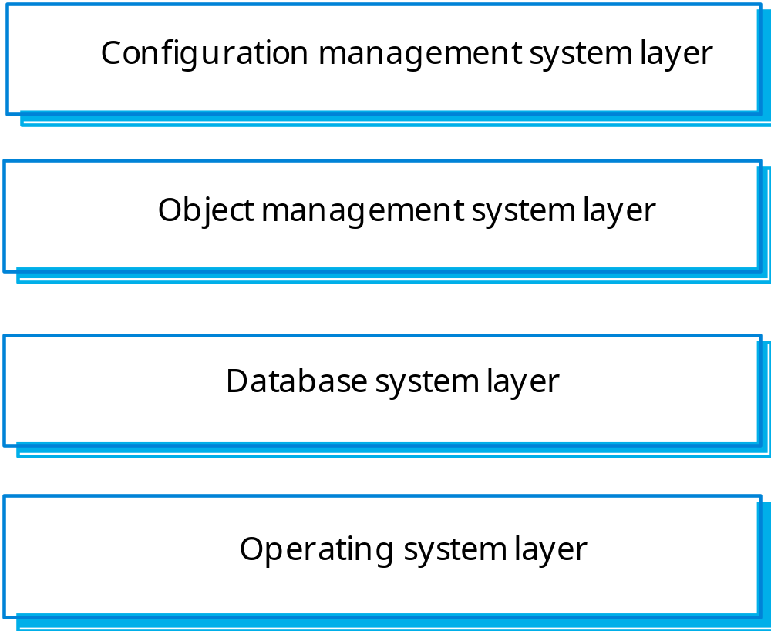
Example-Version management system(Ada Programming support environment structure)

Slide 34
The Layered model
Shows how configuration management system might be integrated using this abstract machine model
Config management system manages
  versions of objects & provides general config management facilities
To support these config management facilities, it uses object management system that provides
  information storage and management services for configuration items or objects.
The system is built on the top of the database system to provide basic data storage and services such as transaction management
The database management uses the underlying operating system facilities and file store in its implementation

Slide 35
The layered model
Disadvantages-
  Structuring system in this way can be difficult.
  Inner layer may provide basic facilities, such as file mgmt. that are required at all levels
  Service required by the user of the top level may have to ‘punch through’ adjacent layers
    to get access to services that are provided several layers beneath it.
  This subverts the model, as the outer layer in the system does not just depend on its immediate predecessor.
  Performance can be a problem because of multiple levels of command interpretation that are sometimes required.

Slide 36
Control models
Concerned with the control flow between sub-systems.
Centralised control
One sub-systemhas overall responsibility for
Control,starts, and stops other sub-systems
Event-based control
Each sub-system can respond to externally generated events from other sub-systems or the system’s environment

Slide 37
Centralised control
A control sub-system takes responsibility for managing the execution of other sub-systems
Two models of centralised control:
1.Call-return control model
2.Manager control mode

Slide 38
Centralised control:
Call-return control model
Top-down subroutine model
Control starts at the top of a subroutine hierarchy and moves downwards.
Applicable to sequential systems

Slide 39
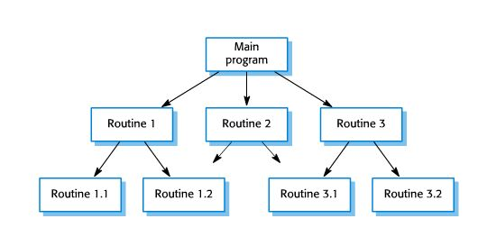
Example: Call-return control model Routine

Slide 40
Centralised control:
Manager control model
One system component controls:
the stopping,
starting and
coordination of other system processes.

Slide 41
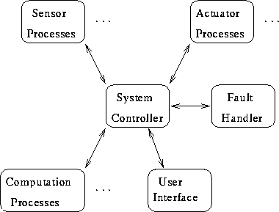
Example: Manager control model for Real-time system control System

Slide 42
Event-driven systems
Driven by externally generated events where the timing of the event is out with the control of the sub-systems which process the event
Two principal event-driven models
Broadcast models. An event is broadcast to all sub-systems. Any sub-system which can handle the event may do so
Interrupt-driven models. Used in real-time systems where interrupts are detected by an interrupt handler and passed to some other component for processing

Slide 43
Event-driven systems:
Broadcast model
Effective in integrating sub-systems on different computers in a network
Sub-systems register an interest in specific events.
--When these occur, control is transferred to the sub-system which can handle the event
Control policy is not embedded in the event and message handler. Sub-systems decide on events of interest to them
However, sub-systems don’t know if or when an event will be handled

Slide 44
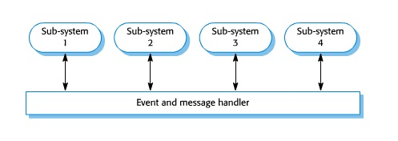
Event-driven systems:
Selective broadcasting

Slide 45
Event-driven systems:
Interrupt-driven systems
Used in real-time systems where fast response to an event is essential
There are known interrupt types with a handler defined for each type
Each type is associated with a memory location and a hardware switch causes transfer to its handler
Allows fast response but complex to program and difficult to validate

Slide 46
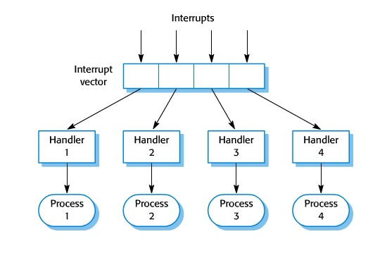
Event-driven systems:
Interrupt-driven control Handler

Slide 47
Modular decomposition
Another structural level where sub-systems are decomposed into modules
Two modular decomposition models covered
An object model: where the system is decomposed into interacting objects
A data-flow model: where the system is decomposed into functional modules which transform inputs to outputs. Also known as the pipeline model

Slide 48
Differences- Subsystem & Modules
A sub-system is a system in its own right whose operation is independent of the services provided by other sub-systems.
A module is a system component that provides services to other components but would not normally be considered as a separate system.
To produce its output it requires other’s input

Slide 49
Modular decomposition styles
After overall system organization is complete, the subsystems are further needs to be decomposed into modules.
Styles of decomposing sub-systems into modules-called modular decomposition.
However, components in modules are usually smaller than subsystems, which allows alternate decomposition styles to be used.

Slide 50
Object oriented decomposition
Structure the system into a set of loosely coupled objects with well-defined interfaces.
Object-oriented decomposition is concerned with identifying object classes, their attributes and operations.
When implemented, objects are created from these classes and some control model used to coordinate object operations.

Slide 51

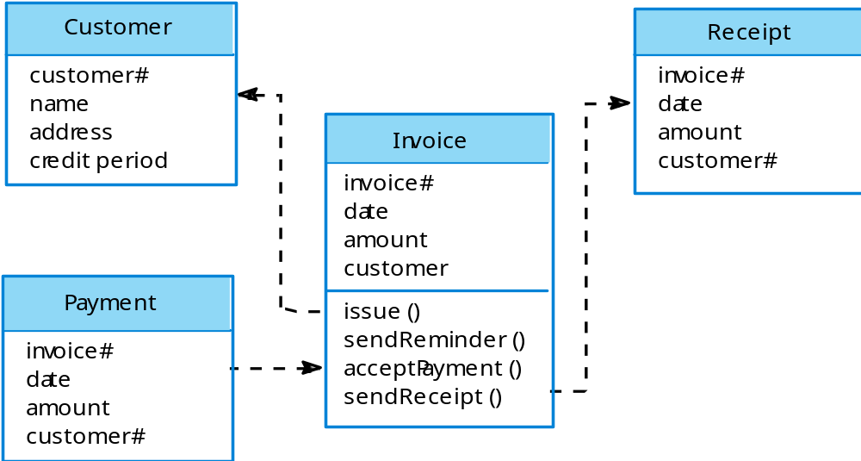
Example-Invoice processing system(OO arch model)

Slide 52
Object Oriented Decomposing
This system can issue invoices to
  customers, receive payments &
  issue receipts for these payments
  Reminders for unpaid invoices
  Object classes have names and a set of associated attributes
  Operations, if any are defined in the lower part of the rectangle representing the object.
  Dashed arrows indicate that an object uses the attributes or services provided by another object.

Slide 53
Object oriented Decomposition-Advantages
Objects are loosely coupled so their implementation can be modified without affecting other objects.
The objects may reflect real-world entities because of which objects can be reused.
OO implementation languages are widely used.
However, object interface changes may cause problems and complex entities(abstract) may be hard to represent as objects.

Slide 54
Function-oriented model (aka data model)
Functional transformations process their inputs to produce outputs.
May be referred to as a pipe and filter model (as in UNIX shell).
Variants of this approach are very common. When transformations are sequential, this is a batch sequential model which is extensively used in data processing systems.
Not really suitable for interactive systems.

Slide 55
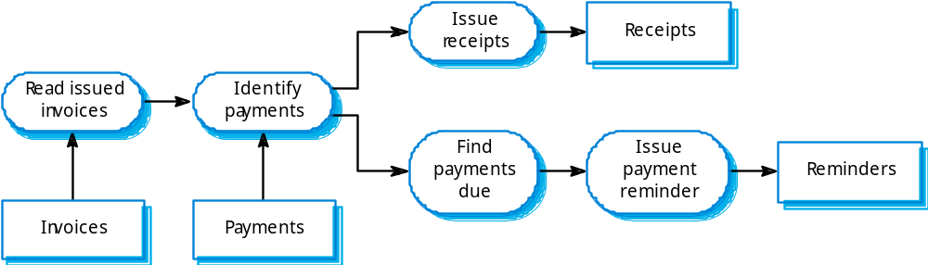
Example-Invoice processing system

Slide 56
Invoice processing system
(in fig.) An Invoice processing system has issued invoices to customers
Once a week, payments that have been made reconciled with the invoices
For invoices that have been paid, a receipt is issued.
For invoices that have not been paid within the allowed payment time, reminder is issued.
This model is only the part of invoice processing system; alternative transformations would be used for the issue of invoices

Slide 57
Pipeline model advantages
Supports transformation reuse.
Intuitive organization for stakeholder communication.
Easy to add new transformations.
Relatively simple to implement as either a concurrent or sequential system.
However, requires a common format for data transfer along the pipeline and difficult to support event-based interaction.

